Slide 1

Computing Lab I – Autumn 2017
Department of Computer Science and Engineering
Know Your Lab !
INDIAN INSTITUTE OF TECHNOLOGY
KHARAGPUR

Slide 2
Your Course Instructors
Sandip Chakraborty
Office: CSE 311
sandipc@cse.iitkgp.ernet.in
http://cse.iitkgp.ac.in/~sandipc/
Saptarshi Ghosh
Office: CSE 305
saptarshi@cse.iitkgp.ernet.in
http://cse.iitkgp.ac.in/~saptarshi
Indian Institute of Technology Kharagpur

Slide 3
Your Mentors – Teaching Assistants (TAs) for this course
Sumitro Bhaumik
sumitros@gmail.com
Soumajit Pramanik
soumajit.pramanik@gmail.com
Shubha Brata Nath
nath.shubha@gmail.com
Indian Institute of Technology Kharagpur

Slide 4
Your Mentors – Teaching Assistants (TAs) for this course
Mayank Tyagi
tyagi.mayank1994411 @gmail.com
Shravan Kumar Singh shan.icwa@gmail.com
Abhishek Tiwari
erabhishektiwarics@gmail.com
Indian Institute of Technology Kharagpur

Slide 5
Lab Timings
A 0-0-6-4 course (6 hours lab duration, 4 credit)
Thursday (2:00 pm – 5:00 pm)
Assignment discussion
Evaluation of previous assignments
Friday (2:00 pm – 5:00 pm)
Doubt clearance
Assignment evaluation
You are encouraged to solve the problems in the lab hours.
Indian Institute of Technology Kharagpur

Slide 6
Lab Syllabus
Algorithms and Data Structures (Python)
Unix process creation – process creation, file handling, managing child processes (C/C++)
Unix shells, file descriptors (C/C++)
OS programming – inter process communication, shared memory, process synchronizations (C/C++)
Data analytics – R programming language for big data analytics
Indian Institute of Technology Kharagpur

Slide 7
General Guidelines
Attendance is compulsory in both the labs
Follow a methodical way for programming
Post your programming doubts first at www.stackoverflow.com
If it is not cleared, post the problem in Piazza group (we’ll create one)
Post the assignment related doubts at Piazza
You are encouraged to actively participate in the Piazza group discussions
Indian Institute of Technology Kharagpur

Slide 8
General Guidelines
You are encouraged to discuss among yourselves, but do not copy the solutions from others
All the copy cases will be treated equally without any further evaluation or discussion – everyone involved will get ZERO marks for that assignment.
Submit the assignments by the deadline – late submission will incur additional penalties.
All the source files of your program need to be uploaded in a single compressed (.tar.gz) file. The file name would be <roll_assignment.tar.gz> (Example: 17CS60R08_A1.tar.gz)
Indian Institute of Technology Kharagpur

Slide 9
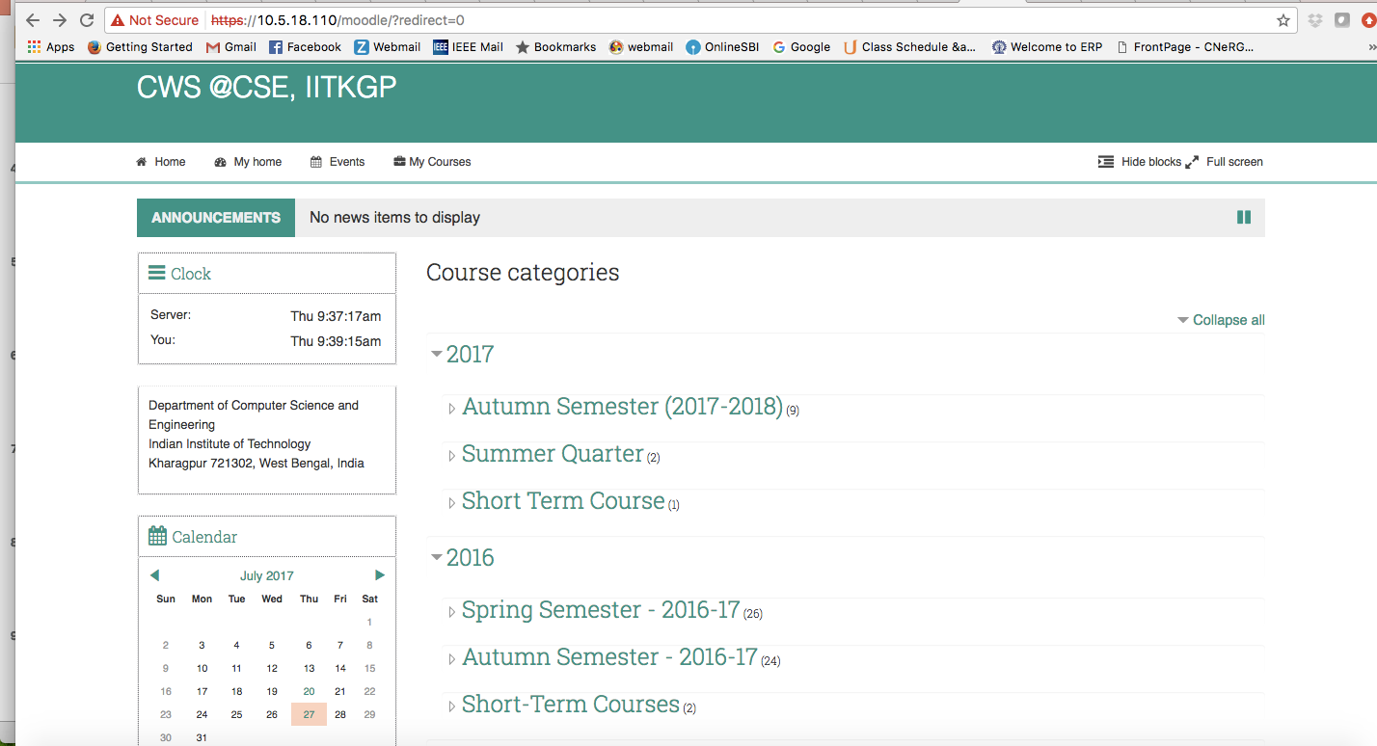
Upload Instructions
Join in the Moodle course page: https://10.5.18.110/moodle/
Indian Institute of Technology Kharagpur

Slide 10
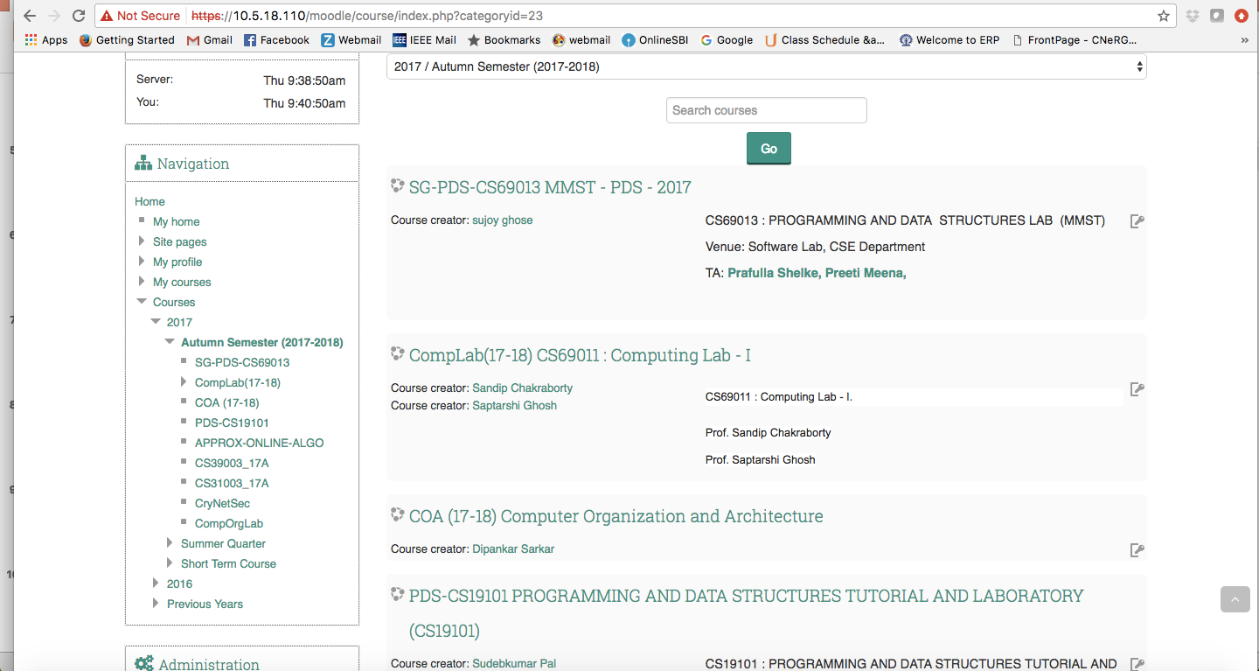
Upload Instructions
Under Autumn Semester (2017-2018), our course is listed.
Indian Institute of Technology Kharagpur

Slide 11
Mode for Assignment Solving
There would be two modes for assignment solving
Individual solving: Everyone need to solve the problem individually
Group solving: Two members need to form a group to solve the problem.
For group solving, form the groups by 24th July, 2017 and mail the group information to Sumitro Bhaumik (sumitros@gmail.com).
Indian Institute of Technology Kharagpur

Slide 12
Mode for Assignment Solving
Email format for informing group formation:
Subject: [CS60019] Group Information
Body:
Member-1 Roll_No
Member-2 Roll_No
Complete this by 24th July, 2017, otherwise random group formation will be done.
Indian Institute of Technology Kharagpur

Slide 13
General Programming Guidelines
Follow proper indentation and variable naming in your code.
A modular coding framework will be appreciated.
Practice debugging – use the gdb debugger.
Maintain proper documentation and commenting inside your code – your code should be written in a way such that everyone else can understand it easily.
Indian Institute of Technology Kharagpur

Slide 14
General Programming Guidelines
Follow these coding standards and guidelines:
GNU coding standards: http://www.gnu.org/prep/standards/html_node/index.html
Google C++ style guide: https://google.github.io/styleguide/cppguide.html
FreeBSD coding style: https://www.freebsd.org/cgi/man.cgi?query=style&sektion=9
Indian Institute of Technology Kharagpur

Slide 15
Evaluation and Grading
General evaluation policy for every assignments:
Correct implementation: 30% - 60%
Algorithmic design: 40% - 70%
Coding style: 10%
The marks distribution will be announced with the assignments.
Final grading policy:
Assignments: 40% (weightage for individual assignments will be adjusted based on their complexities)
Mid term test: 25% (debugging + programming)
End term test: 35% (debugging + programming)
Indian Institute of Technology Kharagpur

Slide 16
Assignment 1 (Basic Python Programming with Graph Data Structure)
This is an individual mode assignment.
Submission deadline: 27th July 2017, 2:00 PM IST
In this assignment, the objective is to learn the basic Python programming by implementing a graph data structure and graph algorithm.
Indian Institute of Technology Kharagpur

Slide 17
Assignment 1 (Basic Python Programming with Graph Data Structure)
Let there be a undirected graph G. The graph will be given as an input to a file, represented as an adjacency list.
Indian Institute of Technology Kharagpur

Slide 18
Assignment 1 (Basic Python Programming with Graph Data Structure)
Part I : Write a python program for finding out all cliques (complete subgraphs) of size k. k will be an input from the terminal.
If k = 3, your output will be,
A B D
A B E
Your algorithm may not be optimal, but optimal solution will be appreciated
Indian Institute of Technology Kharagpur

Slide 19
Assignment 1 (Basic Python Programming with Graph Data Structure)
Part II: Plot G using the tool Graphviz (You need to automate this using Python). Highlight one of the cliques in the plot through a different color, using Graphviz.
Marks distribution:
Part I: 50 (Algorithm: 25, Correct implementation: 20, Coding style: 5)
Part II: 50 (Correct implementation: 20 + 20, Coding style: 5)
In Part I algorithm: Correct but not optimal: 20, Correct and optimal: 25)
Indian Institute of Technology Kharagpur

Slide 20
Computing Lab I
Indian Institute of Technology Kharagpur

